Slide 1
Features of FPXH-C38AT

Slide 2
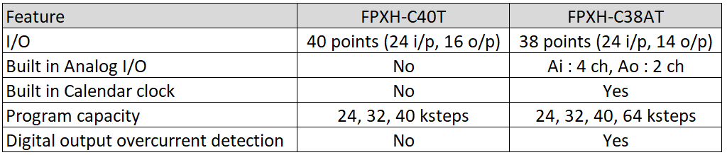
Difference between FPXH-C40T and FPXH-C38AT

Slide 3
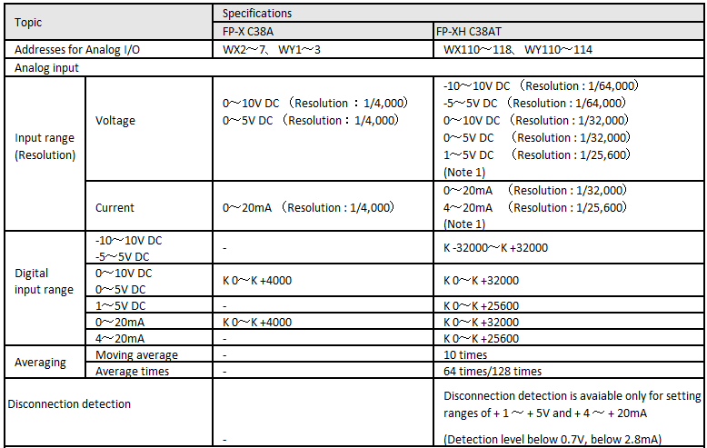
Difference between FPX-C38A and FPXH-C38AT

Slide 4
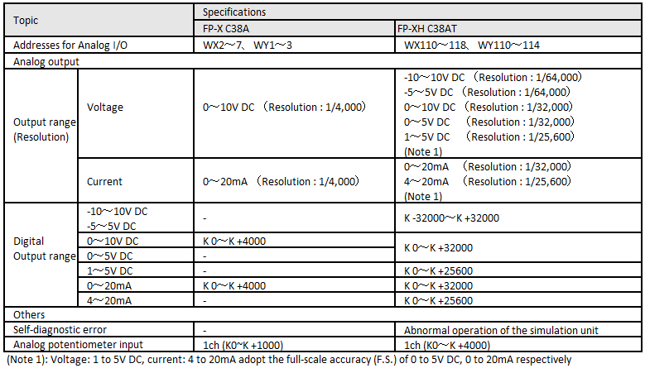
Difference between FPX-C38A and FPXH-C38AT

Slide 5
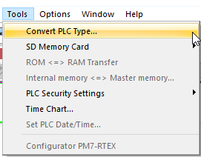
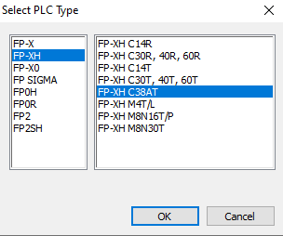
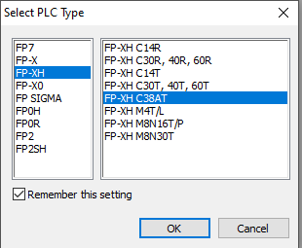
Converting from FPX-C38A
Use "PLC model conversion" to convert the old model FP-X C38A project to the FP-XH C38AT project.
Based on the assumption that the FPWIN GR7 has started the FP-X C38A project, the following description will be made.
After converting from FP-X C38A, "FP-X mode" will be automatically selected

Slide 6
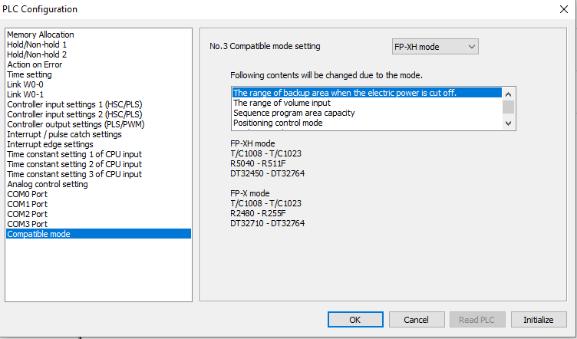
Switching from "FP-X mode" to "FP-XH mode"
Please execute system register No. 3 change in offline mode

Slide 7
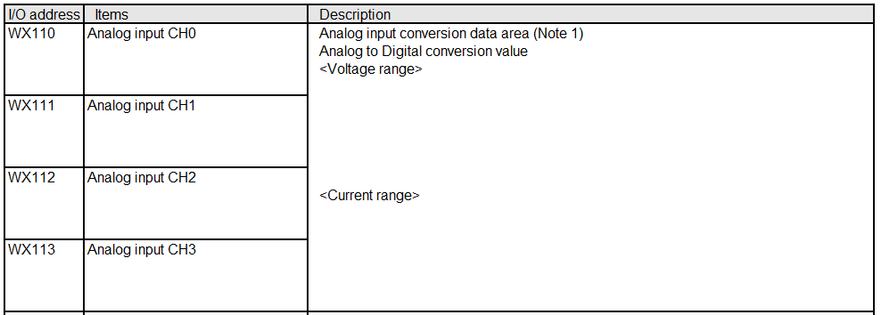


I/O allocation of analog input and output
Analog input and output data will be assigned to external input (WX) and external output (WY). The FP-XH mode and FP-X mode have different I / O assignments.
Address for Input
(Note 1): When switching from RUN mode to PROG. Mode, only the CH whose range setting has been performed will convert the analog input to a digital conversion value.

Slide 8
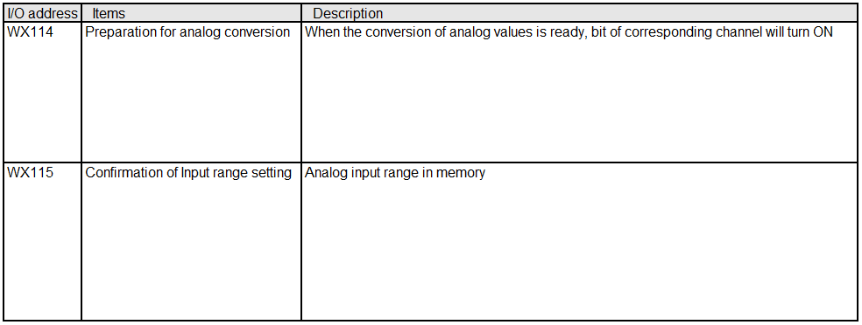
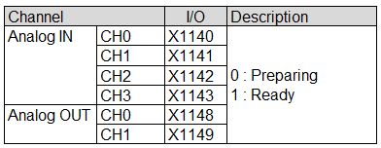
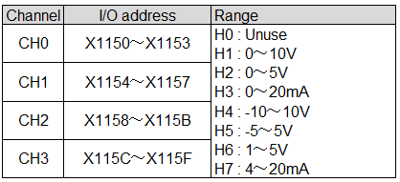
Address for Input

Slide 9
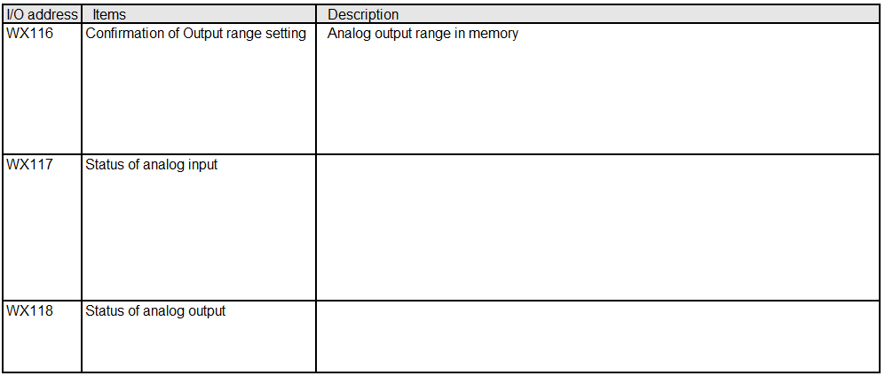
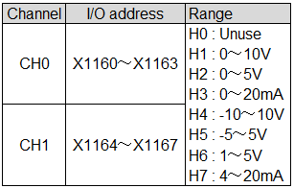
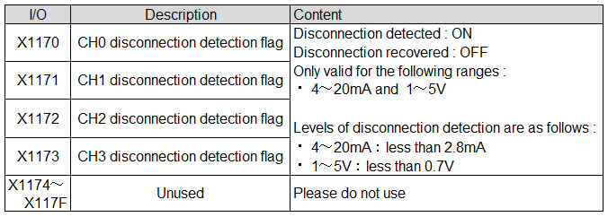
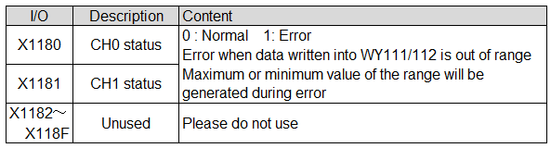

Slide 10
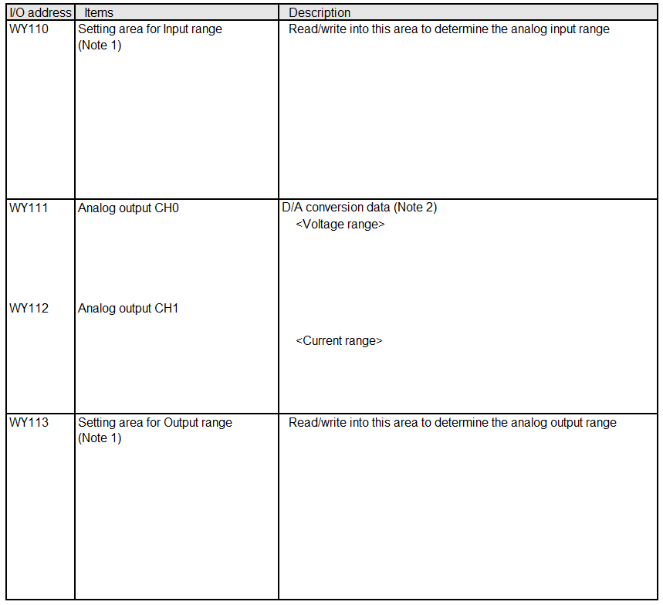
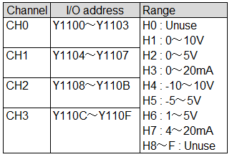


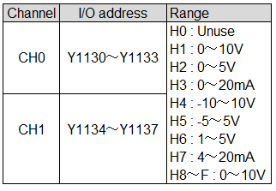

Slide 11

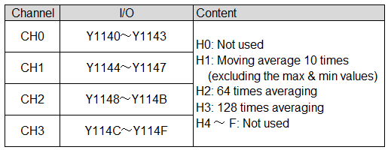
(Note 1) : The validity / invalidity of WY range setting depends on the setting of system register No.450 ～ 451
(Note 2) : After switching from RUN mode to PROG Mode, the analog output will be 1V when 1 to 5V is selected, the analog output when 4 to 20mA is selected is 4mA, and in other cases, 0V or 0mA will be outputted

Slide 12
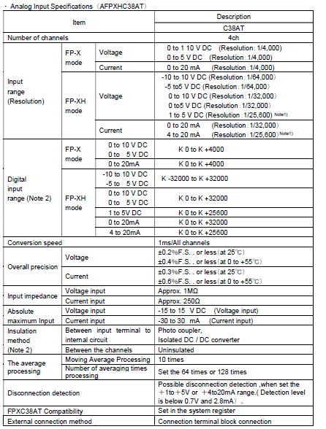
Note 1) Full scale (F.S.) accuracy of the voltage 1 to 5VDC and current 4 to 20mA is based on that of 0 to 5VDC and 0 to 20mA.
Note 2) There is no-isolation between the analog inputs and analog outputs.

Slide 13
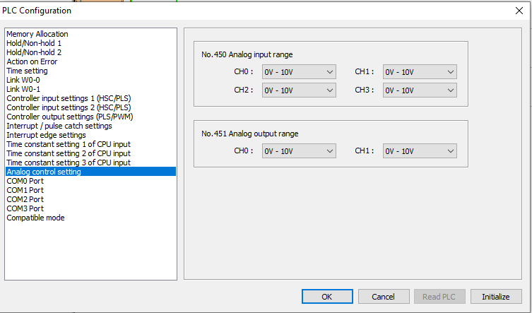
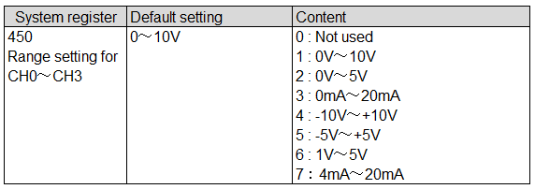
Setting of Analog input range using system registers
When FPXH-C38At is configured to operate in FP-XH mode, range setting of analog input channels can be done in the system registers 450 and 451. Range setting is not possible if it is configured to operate in FP-X mode.

