Slide 1
FP-7 Programmable Controller Multi Input/Output unit
Panasonic Industrial Devices Automation Controls Sales Asia Pacific

Slide 2
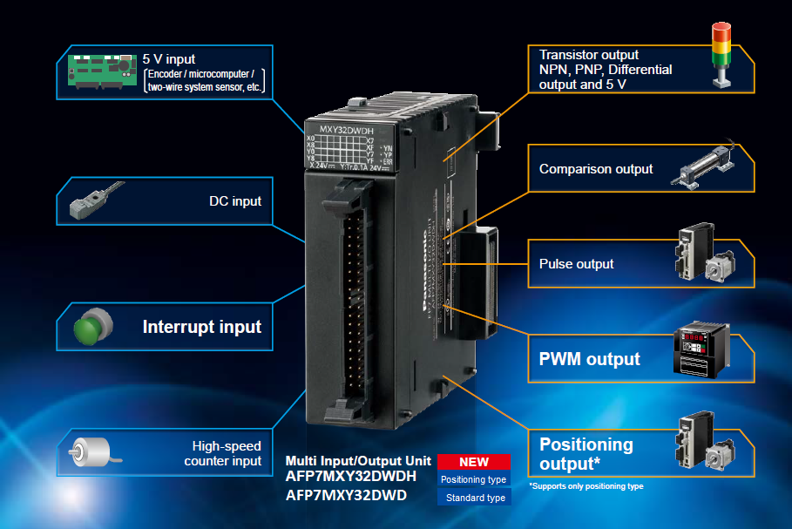
Features
Performs multiple functions with a single unit
All Rights Reserved © Panasonic Corporation

Slide 3
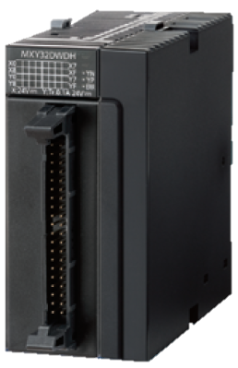
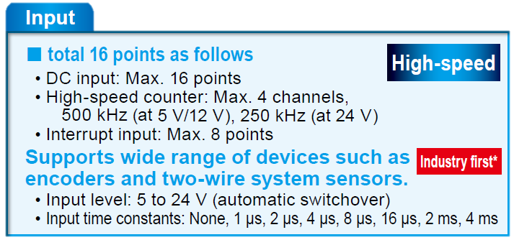
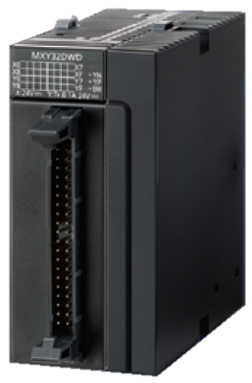

Slide 4
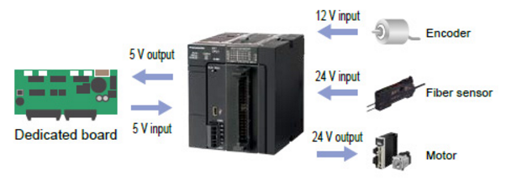
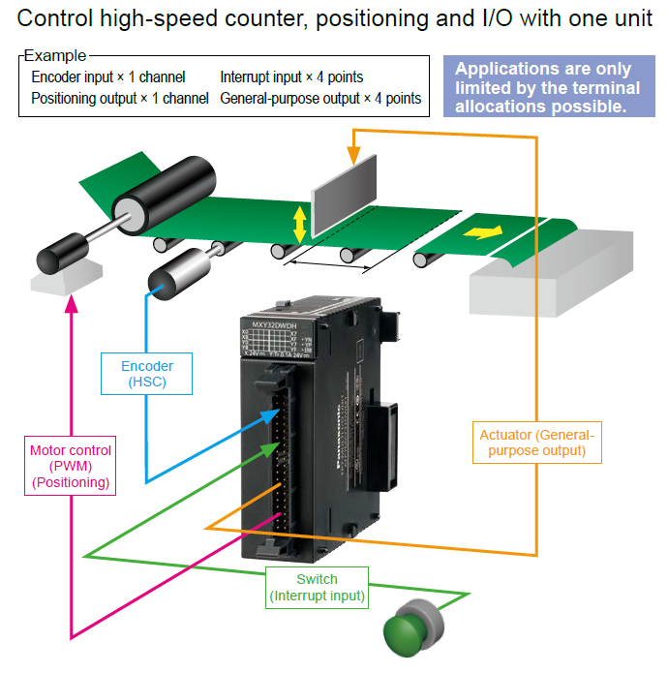
AFP7MXY32DWD (Standard type)
16 digital inputs
16 digital outputs
Normal i/p
Hi Speed Counter
Interrupt i/p
Normal o/p
Pulse
PWM
Comparison
Signal
Sink or source (4 to 1 common)
5/12/24 Vdc
Time filter configurable
Signal
sink, source, push-pull
5-24 Vdc
Pulse
4 channels*
500kHz (50% Duty)
3 modes
Jog (w/o or c/w target)
Hi Speed Counter
- 4 channels
- 3 modes
500kHz, 5Vdc
250kHz, 12-24V
PWM
Interrupt
4 channels
100kHz
- 8 points
External signal or comparison match
Comparison
8 points

Slide 5
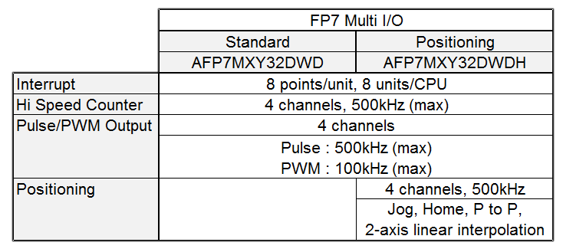
Difference between Standard and Positioning

Slide 6
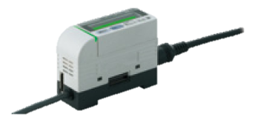
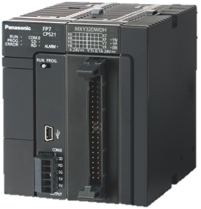
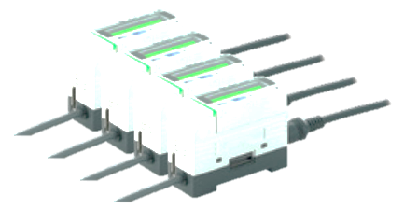
Inputs
Accepts 5 to 24 V input. Lower cost without the need for controllers (converters)
12V
Encoder output
24V
Transistor output
B E F O R E |  |  |  | TR series’ 12V encoder outputs requires additional TR controllers
A F T E R |  |  |  | Since the Multi I/O Unit can accept 12V signal from encoder outputs, controllers is not necessary
Digital I/O
TR Series
TR-C21R-S
12V
Encoder output
Cost saving
Multi I/O
Encoder output connected directly

Slide 7
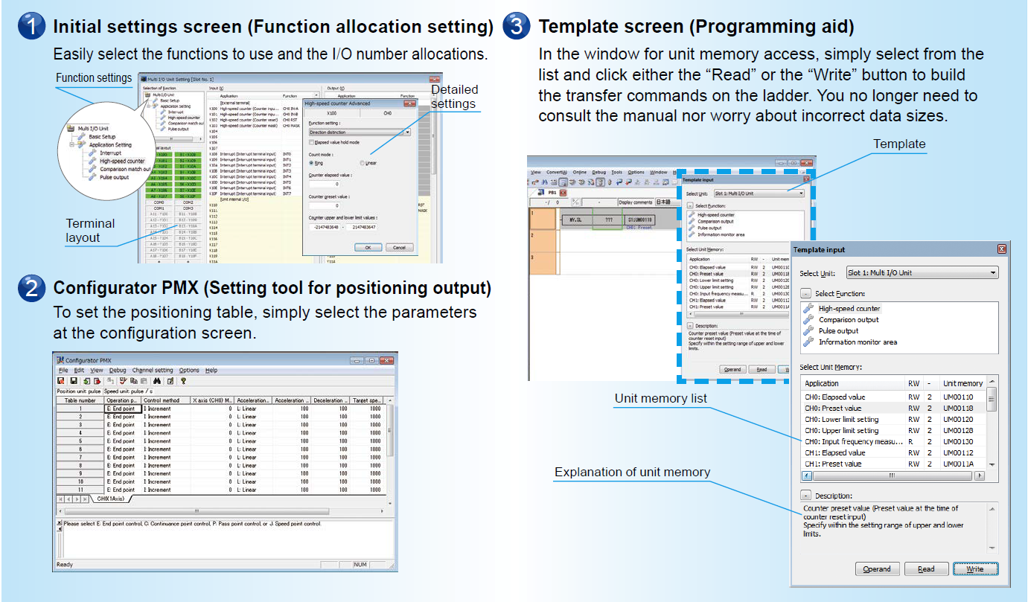
Setting tool and Template in FPWin-Gr7
Configuration of unit can be easily performed using the Setting tool
Template allows programmers to select the UM address without referring to manuals

Slide 8
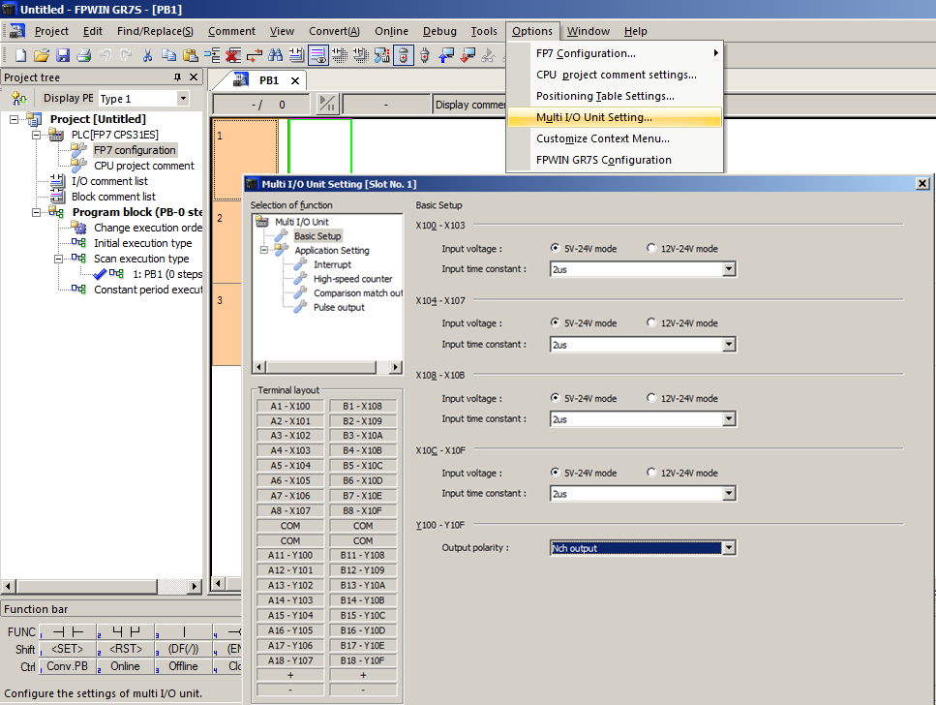
Setting Tool

Slide 9
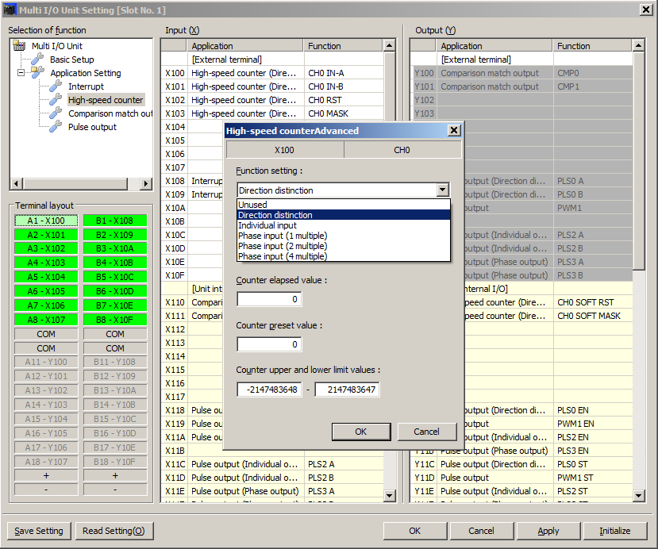
Setting Tool

Slide 10
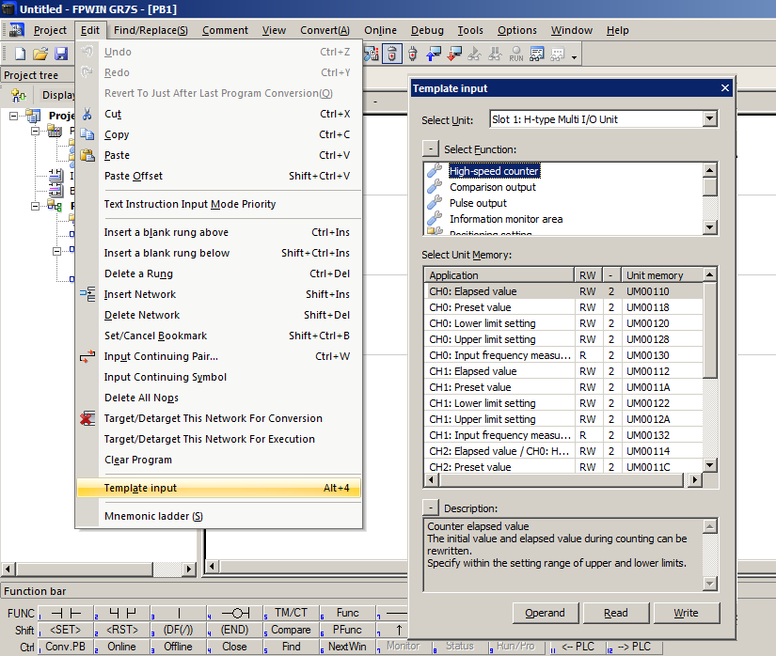
Template

Slide 11
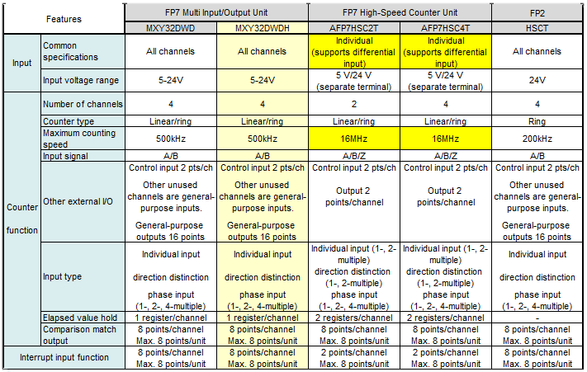
Comparison
(HSC)
Biggest difference between Multi I/O Unit and High-Speed Counter Unit is input of HSC supports differential input
As such, 16 MHz measurement is possible with differential input.
For measuring in the few hundred kilohertz range, the Multi Input/Output Unit can be used.
Multi I/O Unit is a better option than HSC2T when application requires more than just HSC
(This is because unused counter channels of MIO can be used as general-purpose I/Os )

Slide 12
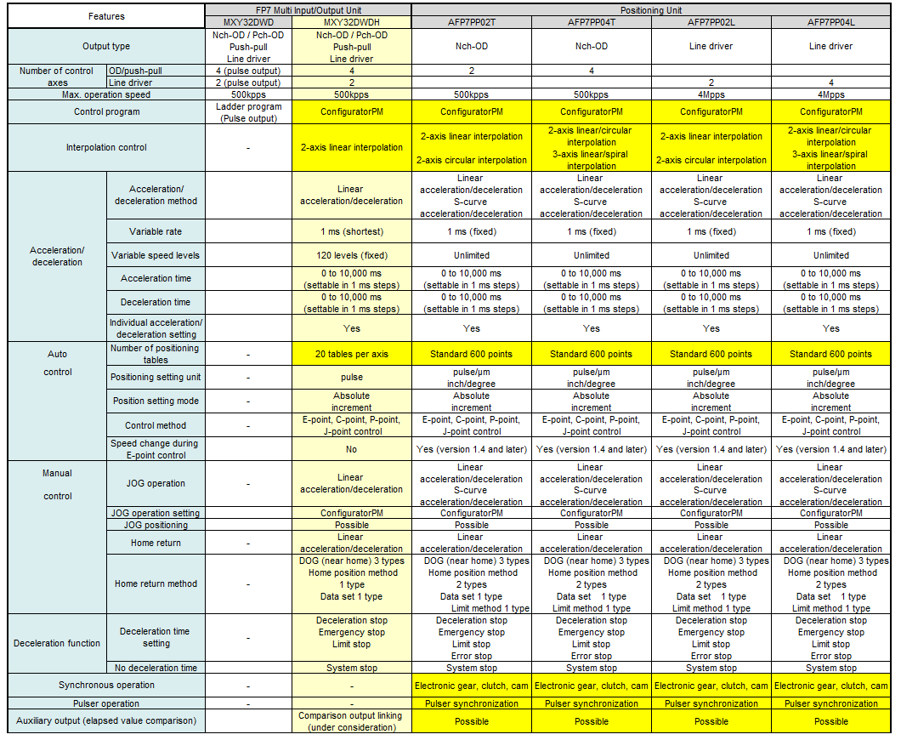
Comparison
Positioning

Slide 13
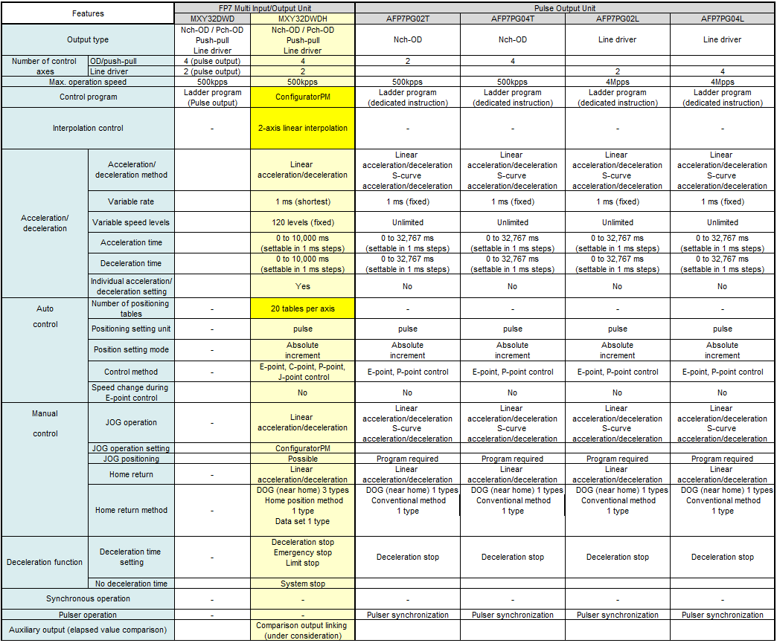
Comparison
Pulse

Slide 14
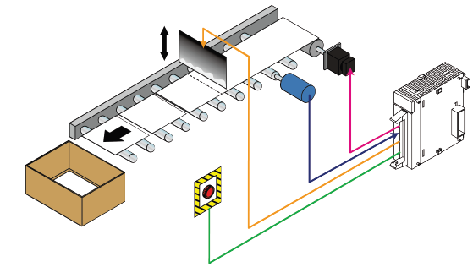
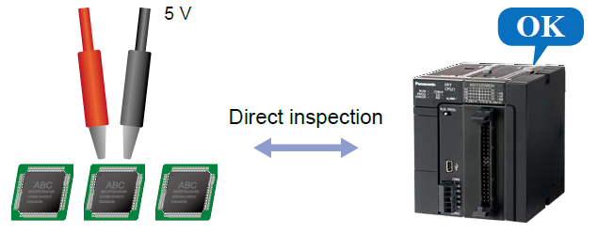
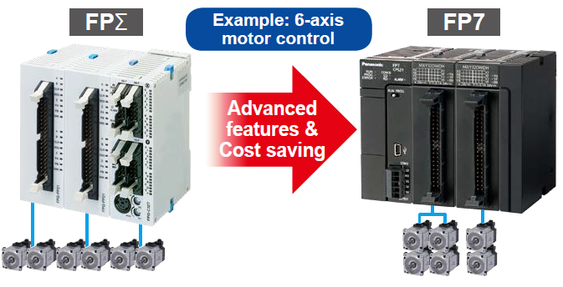
Application Examples
Feature packed unit with easy interface to :-
Measuring instrument and/or equipment tester with 5V output
Motor/inverter control
Dedicated board peripherals

Slide 15
Next…
FP-XH

Slide 16
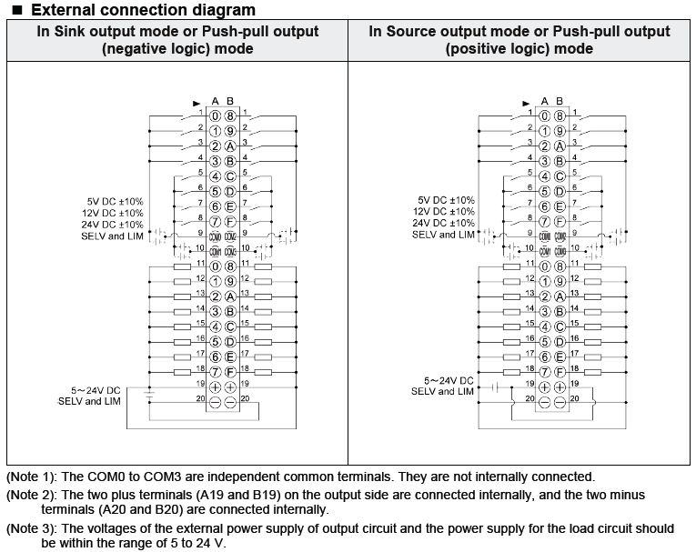
Inputs

