Slide 1
Newly Released PLC product

Slide 2
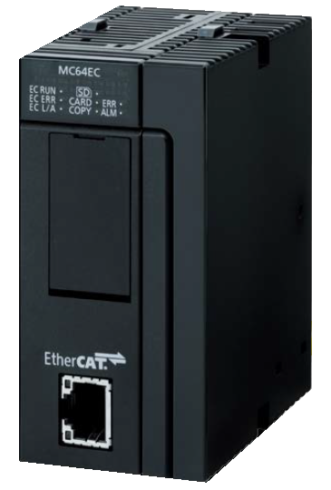
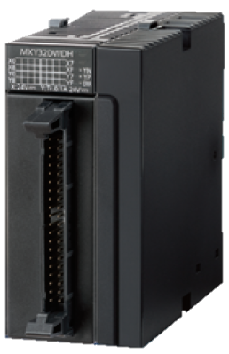
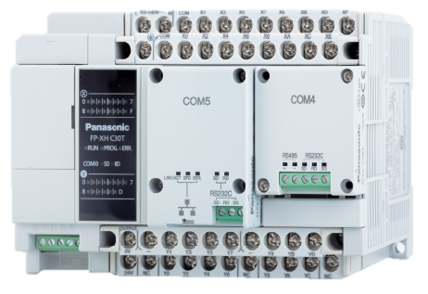
FP7 Motion Control Unit
EtherCAT
FP-XH
Standard/Positioning
FP7 Multi I/O Unit
Standard/Positioning

Slide 3
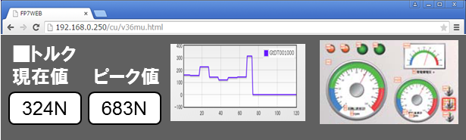
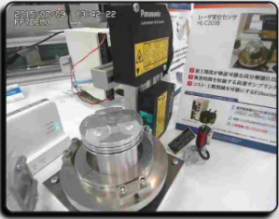



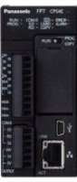
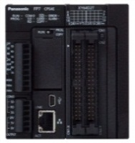
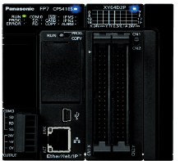
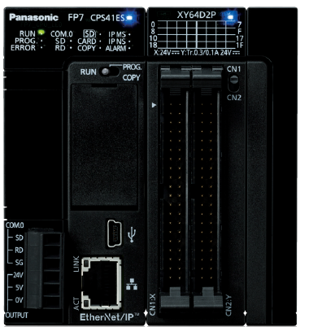




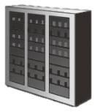
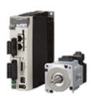
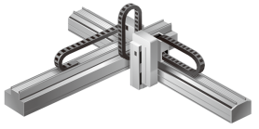
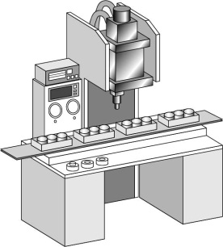
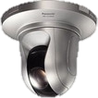
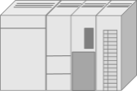
FP7’s Network solution for Motion Control
FP7’ s approach towards networking and IoT
Remote monitoring and control
■Torque
Current Peak
• Servo parameters
• Sensor data
• Camera images
LAN
High-speed motion control
Modbus RTU
Motion control
TCP/IP
A6SF
A5B
Server
PC
Surveillance camera
• Cylinder
• Slider
• Remote I/O
Control & information communication
• FP7
• PLC of various manufacturers
Fieldbus network

Slide 4
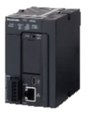
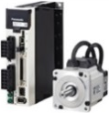
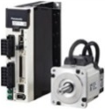

Pulse verse Network
Networking as an alternative
 | Wiring | Topology | Control | Cost
Pulse |  |  | Position information can be obtained. (Wiring for encoder information is necessary between the amplifier and PLC.) | Hardware cost: low Man-hours: large
 |  |  | Position, speed and torque are obtained through LAN cable Less susceptible to noise Easier to increase number of axis | Hardware cost: high Man-hours: small
Network

Slide 5
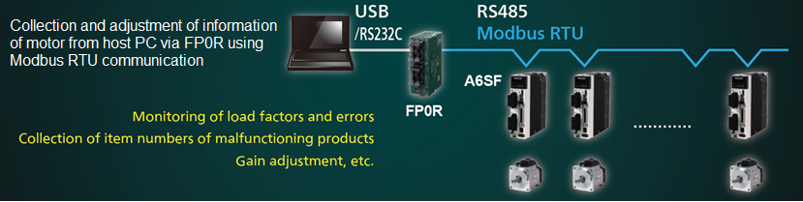
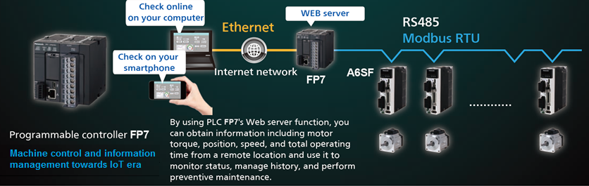
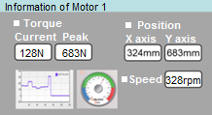
FP7 / FP0R with MINAS A6 (Modbus)
Serial communication (for pulse driven servo drive)
■FP0R Cost effective solution to link MINAS A6 drivers
■FP7 Using web page to monitor status of motor

Slide 6
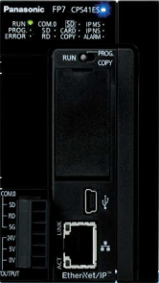

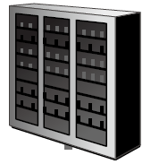

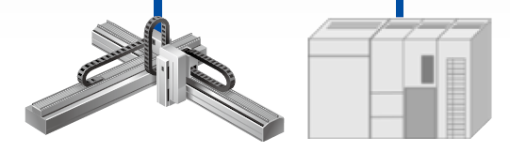




FP7 Ethernet/IP
Multitasking of control and information with EtherNet/IP
Controlling robot, cylinder, monitoring information of PLC from PC, providing information for viewing on Web browser and data transfer to PC servers are easily achieved with FP7
Information
Information
Data storage
Management of archives
Information
PC,
Tablet, etc
Hub
Control
TCP/IP
TCP/IP
Server, etc.
PLC of other manufacturer
Real-time monitor information of connected devices using FP7 Web servers
Linking FP7s together or to PLCs from other manufacturerss is also possible
Easy connection and control with IP robots, cylinders, remote I/O and PLC made by various manufacturers
Link
• FP7
• PLC of other manufacturers

Slide 7

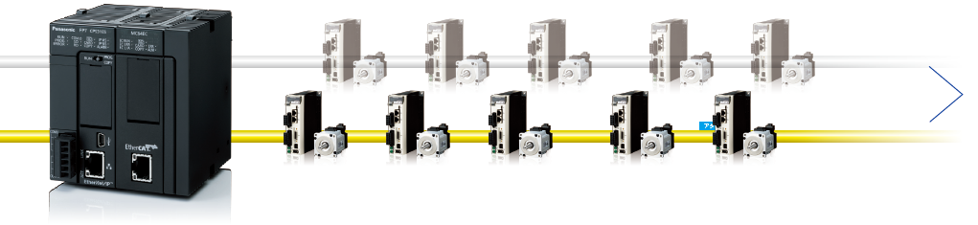

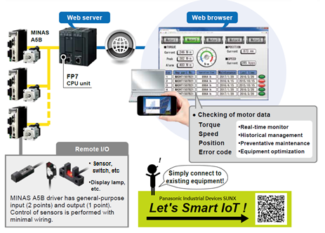
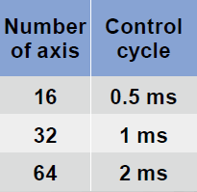
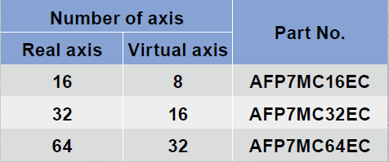
FP7 Motion Control
Type
Controls 64 axis of motor
A Single FP7 Motion Control Unit can Control 64 axis of MINAS A5B and 32 Virtual axes.
Virtual axis
32 axis
Total
96 axis
Real axis
64 axis
■Monitoring operational status of motor
• Up to 32 synchronous groups
(32 groups of 2 axis to 2 groups of 32 axis)
• Control system: Cyclic position control
• Positioning table: 1,000 tables/axis
• Ease of setting motion patterns and test runs using dedicated software tool (Control Motion Integrator)

Slide 8
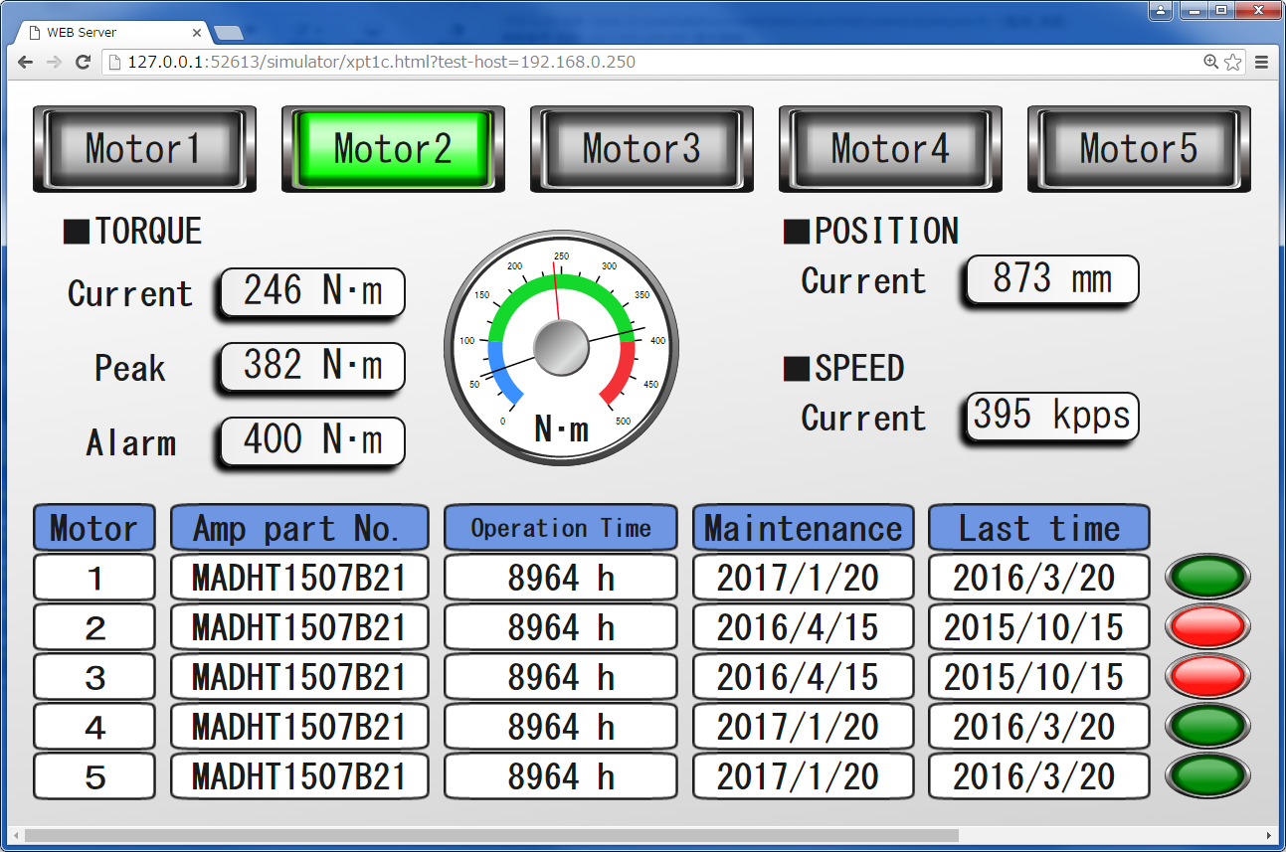
Example of Web Server Screen
Monitoring the operational status of motors and maintenance information
Examples of other control items
• Operation count
→ Preventive maintenance
→ Production count
• Deviation
(Difference between command and encoder)
→ Preventive maintenance
• Torque average
Torque control
→ Preventive maintenance

Slide 9
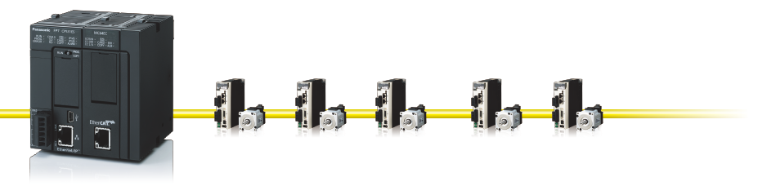
Overview of FP7 Motion Unit

Slide 10
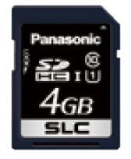
Overview of FP7 Motion Control Unit
Features of the Motion Control Unit
• EtherCAT for the motion network
Supported servo : MINAS A5B
• Number of controllable axis : 64 max.
Each unit is capable of controlling 16, 32, or 64 axis
(Up to 14 motion control units can be supported by a CPU
The number of units that can be added is limited by the power supply
in use and ambient temperature)
• Up to 32 virtual axis can be used
A virtual axis is available for every two physical axis
• Synchronized control of up to 32 groups is possible
Up to 32 axis can be synchronized across various controls (electronic
gear, electronic clutch, electronic cam)
Up to 32 groups of synchronized control can be set up
• Positioning data consisting of 1000 tables/axis can be used
Up to 1000 tables of positioning data can be configured using setting tool
• Supports EtherCAT communications log collection
EtherCAT communication packet data can be saved to SD card
The data can be used to analyze causes of errors
Status indicator LEDs
*Note*
Not EtherCAT master.
SD card slot
EtherCAT communication port
*This requires that the CPU has an Ethernet port

Slide 11
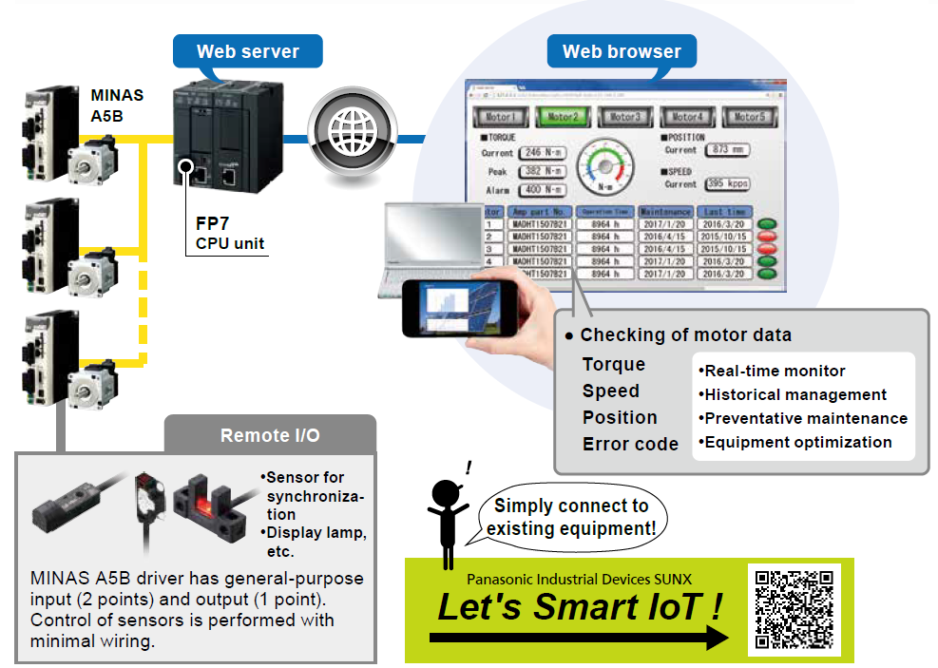
Overview of the Motion Control Unit
A Single FP7 Motion Control Unit can Control 64 axis of MINAS A5B and 32 Virtual axes.
Virtual axis
32 axis
Total
96 axis
Real axis
64 axis
・Up to 32 synchronous groups!
(32 groups of 2 axis to 2 groups of 32 axis)
・Control system: Cyclic position control
・Positioning table: 1,000 tables/axis
・Easy support of motion settings and test runs using dedicated software tool (Control Motion Integrator)
Operational status of motor is remotely monitored. More powerful preventative maintenance and historical management.
Through use of Web server function on FP7 CPU unit, it is possible to remotely monitor items such as torque, speed and position of the motor
Remote I/O with amplifier’s general-purpose input
Sensors are connected as remote I/O by using servo
amplifier’s external terminals “Input SI” and “Output SO”.
Total monitoring of operation as well as peripheral sensors
can be achieved.

Slide 12
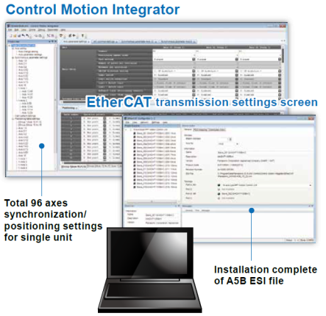


Product Lineup of Motion Control Unit
■FP7 Motion control unit EtherCAT type: 3 types
-16 axis (AFP7MC16EC)
-32 axis (AFP7MC32EC)
-64 axis (AFP7MC64EC)
■FP7 Motion control setting tools
Control Motion Integrator English version (AFPSMTEN)
• Downloadable free of charge from our website.
• Only the EtherCAT communication setting portion of the tool is provided as a key unit.
AFPSMTKEY (USB dongle) is required.
• After installation, the tool can be used for 60 days without the key unit.
■Programming tools FPWIN-GR7, FPWIN-Pro7
Supports motion control units
Supplementary explanation
• The key unit is not required when setting motion
• The key unit runs regardless of which PC it is used with
• For control using two PCs simultaneously, additional key unit is required
• Can be used as a trial version.

Slide 13
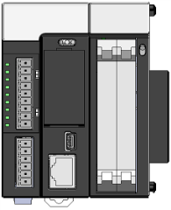

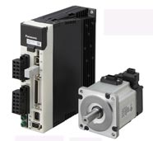
System Configuration Example
FP7
CPU unit
Motion Control Unit
(16, 32, or 64 axis per unit)
PanaTerm
USB
Ethernet/USB/COM
16 to 64 axis
Setting data of Motion control unit can be transferred or saved in motion control unit
FP7 programming tool
(FPWIN-GR7)
Setting tool (Control Motion Integrator)
• Positioning, synchronization setting, axis operation setting
• Tool operation (test operation mode)
• Various monitors

Slide 14
Specifications
Item |  |  | Description
Part No. |  |  | AFP7MC16EC | AFP7MC32EC | AFP7MC64EC
No. of control axes |  |  | Real axis: 16 axis Virtual axis: 8 axis | Real axis: 32 axis Virtual axis: 16 axis | Real axis: 64 axis Virtual axis: 32 axis
No. of occupied I/O points |  |  | Input: 16 points, Output: 16 points
 |  | Interpolation control | 2-axis linear interpolation, 2-axis circular interpolation, 3-axis linear interpolation, 3-axis spiral interpolation
 |  | Position specification method | Absolute (specified absolute position), Increment (specified relative position)
 |  | Position specified unit | Pulse / μm (0.1μm, 1μm) / inch (0.00001inch, 0.0001inch) / degree (0.1degree, 1degree)
 |  | Position reference range | Pulse: -2,147,483,648 to 2,147,483,647pulse μm（0.1μm）: -214,748,364.8 to 214,748,364.7μm μm（1μm）: -2,147,483,648 to 2,147,483,647μm inch（0.00001inch）: -21,474.83648 to 21,474.83647inch inch（0.0001inch）: -214,748.3648 to 214,748.3647inch degree（0.1degree）: -214,748,364.8 to 14,748,364.7degree degree（1degree）: -2,147,483,648 to 2,147,483,647degree
 |  | Speed reference range | pulse：1 to 32,767,000pps μm：1 to 32,767,000μm/s inch：0.001 to 32,767.000inch/s degree：0.001 to 32,767.000rev/s
 |  | Acceleration/deceleration type | 0 to 10,000 ms (adjustable in 1-ms increments), Linear acceleration/deceleration, S-shaped acceleration/deceleration
 |  | No. of positioning tables | Each axis: 1000 points (when setting, Recalculation is needed.)
 |  | Independent axis | PTP control (E- and C-point control), CP control (P-point control), JOG positioning control (J-point control)
 |  | 2-axis interpolation | Linear Interpolation: E-, P-, C-point control; composite speed or long-axis speed specification Circular Interpolation: E-, P-, C-point control; center or passing point specification
 |  | 3-axis interpolation | Linear Interpolation: E-, P-, C-point control; composite speed or long-axis speed specification Circular Interpolation: E-, P-, C-point control; center or passing point specification
 |  | No. of interpolation group | Max. 8 groups | Max. 16 groups | Max. 32 groups
 |  | Other functions | Dwell time: 0 to 32,767 ms (Settable by 1 ms),
Positioning control
Automatic operation

Slide 15
Specifications
Item |  |  |  | Description
Part No. |  |  |  | AFP7MC16EC | AFP7MC32EC | AFP7MC64EC
 | Basic setting | Synchronous function |  | Electronic gear, Electronic clutch, Electronic cam
 |  | No. of master axes |  | Real axis: 16 axis Virtual axis: 8 axis | Real axis: 32 axis Virtual axis: 16 axis | Real axis: 64 axis Virtual axis: 32 axis
 |  | No. of maximum synchronous axes |  | Max. 16 axis/master | Max. 32 axis/master | Max. 64 axis/master
 |  | Slave axis |  | Real axis: 16 axis | Real axis: 32 axis | Real axis: 64 axis
 |  | Selectable synchronous/ non-synchronous |  | Selectable by ladder programs
 | Electronic gear |  |  | Gear ratio setting while operation (acceleration/deceleration)
 | Electronic clutch |  |  | Clutch operation trigger: level, ON/OFF trigger Clutch operation: Direct method, linear slide method
 | Electronic cam |  | Resolution | 1024, 2048, 4096, 8192, 16384, 32768
 |  |  | Cam curve | Select from 20 types. Multiple curves can be specified within phase
 |  |  | No. of cam patterns | 16 (resolution 1024) to 64 (resolution 32748) (According to resolution) | 128 (resolution 1024) to 32 (resolution 32748) (According to resolution) | 256 (resolution 1024) to 64 (resolution 32748) (According to resolution)
 | JOG operation |  | Acceleration/deceleration type | 0 to 10,000 ms Linear acceleration/deceleration, S acceleration/deceleration
 |  |  | JOG operation | Operate continuously while request ON. (Speed can be changed while operation)
 |  |  | Inching operation | Operate the inching movement amount by request ON.
 | Home return |  | Home return speed | Home return speed, Home return speed creep speed
 |  |  | Acceleration/deceleration type | 0 to 10,000 ms Linear acceleration/deceleration, S acceleration/deceleration
 |  |  | Home return | DOG method (4 types), Limit method (2 types), Z phase method, Stop-on-contact method (2 types), Data set method
Synchronous operation
Manual operation

Slide 16
Specifications
Item |  | Description
Part No. |  | AFP7MC16EC | AFP7MC32EC | AFP7MC64EC
Stop function | Deceleration stop | Stop in deceleration time (each axis)
 | Emergency stop | Stop in emergency stop deceleration time (each axis)
 | System stop | Immediate stop in deceleration time 1 ms (all axes)
 | Limit stop | Stop in limit stop time when both limit signal + and - are ON.(each axis)
 | Error stop | Stop in error stop deceleration time (each axis)
Other functions | Software limit | Select whether to enable or disable for positioning / JOG operation / home return
 | Backup | The data of communication parameters, positioning parameters and positioning tables is saved in the FROM within the unit (without battery).
 | Axis operation deviation check | Check the deviation between position command value and feedback
 | General-purpose input | The input of servo motor MINAS A5B can be used via EtherCAT. Limit signal is ineffective: Max. 5 points Limit signal is effective: Max. 3 points
 | General-purpose output | The input of servo motor MINAS A5B can be used via EtherCAT. 1 point
 | Setting tool | Control Motion Integrator (Can be set with ladder programs as well)
 | Tool operation (Test operation) | Use with Control Motion Integrator (No ladder program necessary)
 | SD card | For store EtherCAT communication logs
EtherCAT | Connectable device | Panasonic Servo AMP MINAS A５B
 | Station address setting method | Set with Control Motion Integrator
 | Cable | Shielded cable (Category 5e or higher)
 | Cable length | Max. 100 m between nodes
Current consumption (24V DC） |  | 180mA approx.
Weight |  | 150g approx.

Slide 17
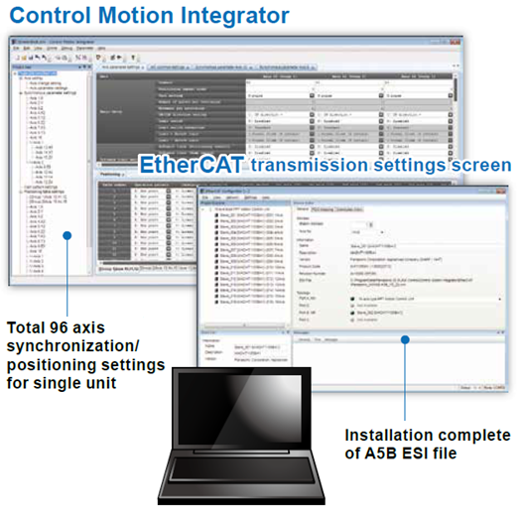
Setting Tool Software (Control Motion Integrator)
• EtherCAT communication settings
• Unit’s motion control (positioning, synchronization, etc.) settings
• Tool operation
: Operation check at startup during testing (no PLC program required)

Slide 18
Control Motion Integrator Setting Flowchart
Set the axis to be used
Register the axis used by the motion control unit and set interpolation groups.
Specify EtherCAT communication settings.
Associate station addresses and axis numbers.
Set various operations (home return, positioning, synchronous operation, etc.).
Save parameters in the motion control unit.
Restart the PLC system and servo amplifier only when changes are made to settings related to EtherCAT communication
Set the part numbers and the number of amplifiers to be used and station addresses
(EtherCAT communication settings)
Set other parameters
(axis parameters,
interpolation, synchronization)
Download
Restart the system
(when EtherCAT settings are changed)

Slide 19
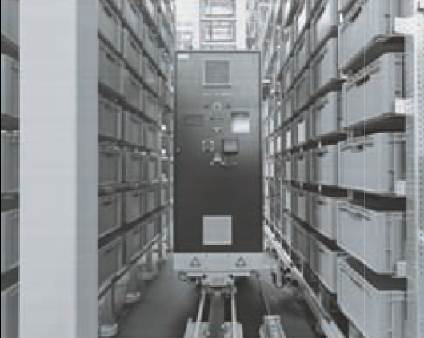
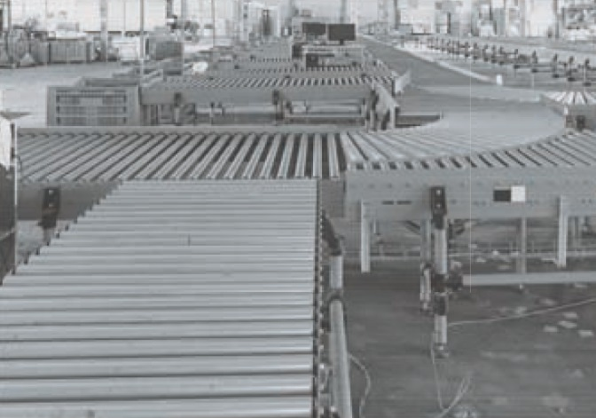

Application Example
Automated warehouse
Logistics
Conveyor line
LCD panel conveyance
Tray
<LCD conveyance example>
Six axes in one group and eight conveyance sections
Total of 48 axis in use
⇒ Wiring man-hour and cost merits are on the next page.
10th generation
LCD panel
X-axis movement (conveyance)
○ ○ ○ ○ ○ ○

Slide 20
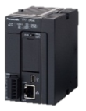




Configuration Comparison
(Example of comparing the wiring of 6 axis, 8 groups)
<Example > When 6-axis conveyance sections control eight locations (48 axis total)
+
Pulse
4 axis (AFP7PP04T)
× 12 units
CPU
[A5B]
Significant cost reduction is possible
+
Conveyance section 1
Conveyance section 2
Conveyance section 3
Conveyance section 4
Conveyance section 5
Conveyance section 6
Conveyance section 7
Conveyance section 8
Network
48 axis (AFP7MC64EC)
× 1 unit
AFP7MC64EC
LAN
One unit controls 64 axis
• Great size and cost merits
• Man-hour reduction through daisy-chain connection
Conveyance section 1
Conveyance section 2
Conveyance section 3
Conveyance section 4
Conveyance section 5
Conveyance section 6
Conveyance section 7
Conveyance section 8

Slide 21
Next…
FP7 Multi I/O unit

